Slide 1
Module 14: Troubleshooting
Notes:
Welcome to Module 14, which focuses on troubleshooting tips.

Slide 2
What’s in This Module
Part 1: Troubleshooting Steps
Part 2: AWS Support Options
Notes:
In part 1, you will learn some troubleshooting steps you can follow when you encounter common errors.
In part 2, you will review the various AWS Support Options available.

Slide 3
Module Objectives
Upon completing this module, you will be able to:
Troubleshoot common errors.
Discover various AWS Support Options available.
Notes:
After completing this module, you will be able to:
Troubleshoot common errors, and
Access various AWS Support Options

Slide 4
Troubleshooting Common Errors
Notes:
Let’s review some common troubleshooting errors.

Slide 5
"My instance connection timed out."
Notes:
Let’s begin with a common question, “What steps should I take if my instance connection timed out?”

Slide 6

Instance Connection Timed Out
Check your routes.
Is your routing table configured correctly?
Public subnets need Internet-bound traffic routed to an IGW.
If you're using a virtual private gateway, is your VPN routed correctly?
Make sure you're using the correct routing type for your VPN router (Dynamic or Static).
Destination | Target
10.0.0.0/16 | Local
0.0.0.0/0 | IGW
Notes:
If your instance connection timed out, first check your routes.
Next, confirm that your routing table is configured correctly. Public subnets need internet-bound traffic routed to an IGW.
If you're using a virtual private gateway, check that your VPN is routed correctly. Make sure you're using the correct routing type for your VPN router—either dynamic or static.

Slide 7

Instance Connection Timed Out
Check your security group rules.
Instances need both inbound and outbound rules permitting traffic.
Without rules, security groups deny all traffic, by default.
Don't leave your security group completely open.
Publicly accessible hosts should be behind another layer of access that offers control (DNS, AWS WAF, ELB).
security group
Inbound: 0.0.0.0/0
Notes:
If your instance connection is still timed out after you check your routes, routing table, and VPN router, check your security group rules.
Instances need both inbound and outbound rules permitting traffic. Without rules, security groups deny all traffic, by default.
Don't leave your security group completely open. Publicly-accessible hosts should be behind another layer of access that offers control, such as DNS, AWS WAF, or ELB.

Slide 8
Instance Connection Timed Out
Check your network ACLs.
Verify that your network ACLs allow traffic to and from your computer.
If applicable, check your corporate network's internal firewall.
Port 22 for Linux instances and port 3389 for Windows instances must be open to enable remote control via SSH for Linux or RDP for Windows.
Make sure your instance has a public IP address.
If you forgot to give it one, you can attach an elastic IP address without having to restart your instance.
Check the CPU load on your instance; it may be overloaded.
Use Amazon CloudWatch to check CPU use. If your instance is overloaded, consider scaling up to a larger instance type or scaling out to more instances running in parallel behind a load balancer.
Notes:
Finally, check your network ACLs. Verify that your network ACLs allow traffic to and from your computer.
If applicable, check your corporate network's internal firewall. Port 22 for Linux instances and port 3389 for Windows instances must be open to enable remote control via SSH for Linux or RDP for Windows.
Make sure your instance has a public IP address. If it doesn’t have one, you can attach an elastic IP address, without having to restart your instance.
Check the CPU load on your instance. It may be overloaded. Use Amazon CloudWatch to check CPU use. If your instance is overloaded, consider scaling up to a larger instance type or scaling out to more instances running in parallel behind a load balancer.

Slide 9
"My network performance is poor."
Notes:
Now, let’s review some steps to take if your network performance is poor.

Slide 10


Poor Network Performance
Consider changing your instance type.
Are you using an instance type with enhanced networking?
Enhanced networking provides high performance (packets per second), low latency, and low jitter.
If you're using a NAT instance on Amazon EC2, does it need to be scaled up to a larger size?
AWS NAT Gateways is equipped for handling high network throughput needs.
Amazon EC2
VPC NAT gateway
Notes:
If your network performance is poor, consider changing your instance type.
Are you using an instance type with enhanced networking? Enhanced networking provides higher performance, additional packets per second, lower latency, and lower jitter.
If you're using a NAT instance on Amazon EC2, does it need to be scaled to a larger size? An AWS NAT Gateway is equipped to handle high network throughput needs.

Slide 11



Poor Network Performance
If used, make sure jumbo frames are enabled correctly.
If one instance has jumbo frames enabled, make sure all instances (including NAT instances) that it communicates with also have jumbo frames enabled.
Consider VPC endpoints and AWS PrivateLink where possible.
Connections between VPC resources and Amazon S3 will likely be faster if they use an Amazon S3 VPC endpoint instead of traversing the internet.
Amazon EC2
VPC Endpoint
Notes:
If used, make sure jumbo frames are enabled correctly. If one instance has jumbo frames enabled, make sure all instances—including NAT instances—that it communicates with also have jumbo frames enabled.
Consider VPC endpoints and AWS PrivateLink where possible. Connections between VPC resources and Amazon S3 will likely be faster if they use an Amazon S3 VPC endpoint instead of traversing the internet.

Slide 12
“My I/O to my Amazon EBS volumes is too low.”
Notes:
Now, consider what you can do if the input/output to your Amazon Elastic Block Store volumes is too low.

Slide 13

I/O Volume Is Low.
Review your instance and EBS types.
Are you using EBS-optimized instance types?
EBS-optimized instance types are designed for applications with heavy disk I/O.
Are you using an EBS type with high I/O?
Provisioned IOPS SSDs can provision up to 32,000 IOPS per volume.
Amazon EC2
Amazon EBS
Notes:
If the input/output to your Amazon Elastic Block Store volumes is too low, review your instance and Amazon EBS types.
Are your instance types optimized for Amazon EBS? Instance types optimized for EBS are designed for applications with heavy disk input/output.
Are you using an EBS type with high input/output? Provisioned IOPS SSDs can provision up to 32,000 IOPS per volume.

Slide 14
"The CPU load on my Amazon RDS instances is too high."
Notes:
What if the CPU load on your Amazon Relational Database Service instances is too high?

Slide 15
CPU Load
Optimize your queries.
Determine which of your queries are slowest, and review them to determine if they can be optimized.
Use read replicas.
Letting a read replica handle read requests relieves the CPU load on your master RDS instance.
Ensure you're using the best instance type.
Your queries might require more CPU or memory. Test your queries against more powerful instance types to see if you should switch.
Notes:
If the CPU load on your Amazon RDS instances is too high, optimize your queries. Identify which queries are slowest, and review them to determine if they can be optimized.
Use read replicas. Letting a read replica handle read requests relieves the CPU load on your master RDS instance.
Ensure you're using the best instance type. Your queries might require more CPU or memory. Test your queries against more powerful instance types to see if you should switch.

Slide 16
"I get 'access denied' when I make a request to an AWS service."
Notes:
What if you get an ‘access denied’ error when making a request to an AWS service?

Slide 17



Access Denied
Verify you have permission to call the action on that resource.
If any conditions are set, you must meet those conditions, as well.
Verify resource policies, if any, specify you as a principal and grant you access.
Services like Amazon S3, Amazon SNS, and Amazon SQS have resource-based policies.
permissions
Amazon S3
Amazon SNS
Amazon SQS
Notes:
If you receive an access denied error when attempting to make a request to an AWS service, verify you have permission to call the action on the resource.
If any conditions are set, you must meet those conditions, as well.
Also, verify resource policies, if any, specify you as a principal and grant you access. Services like Amazon Simple Storage Service, Amazon Simple Notification Service, and Amazon Simple Queue Service have resource-based policies.

Slide 18
AWS Support Options
Notes:
Finally, let’s review the various AWS Support Options.

Slide 19

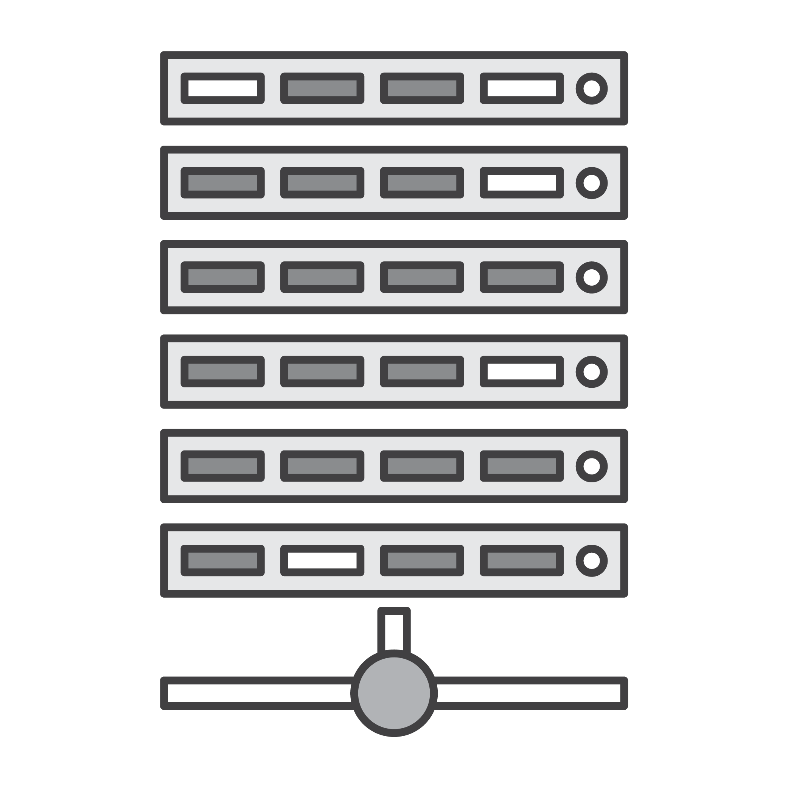


AWS Support Options
The Technical Account Manager provides...
A dedicated voice within AWS to serve as your advocate.
Proactive guidance and insight into ways to optimize AWS through business and performance reviews.
Orchestration and access to the full breadth and depth of technical expertise across the full range of AWS.
Access to resources and best practice recommendations.
Infrastructure Event Management provides...
A common understanding of event objectives and use cases through pre-event planning and preparation.
Resource recommendations and deployment guidance based on anticipated capacity needs.
Dedicated attention of your AWS Support team during your event.
The ability to immediately scale down resources to normal operating levels post-event.
Notes:
The Technical Account Manager provides:
• A dedicated voice in AWS to serve as your advocate.
• Proactive guidance and insight into ways to optimize AWS through business and performance reviews.
• Orchestration and access to the full breadth and depth of technical expertise across the full range of AWS.
• And access to resources and best practice recommendations.
Infrastructure Event Management provides:
• A common understanding of event objectives and use cases through pre-event planning and preparation.
• Resource recommendations and deployment guidance based on anticipated capacity needs.
• Dedicated attention of your AWS Support team during your event.
• And the ability to immediately scale down resources to normal operating levels post-event.
Select the link to learn more.
https://aws.amazon.com/premiumsupport/

Slide 20
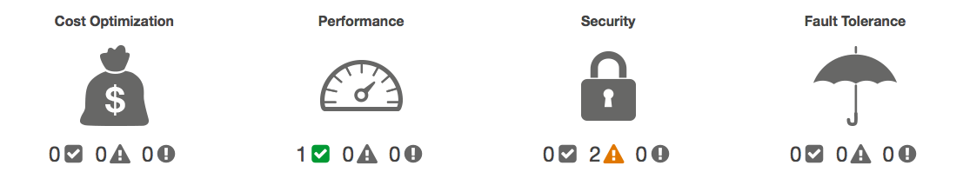
AWS Support Options
The Concierge Service provides...
A primary contact to help manage AWS resources.
Personalized handling of billing inquiries, tax questions, service limits, and bulk reserve instance purchases.
Direct access to an agent to help optimize costs to identify underutilized resources.
Trusted Advisor provides...
Insight into how and where you can get the most impact for your AWS spend.
Opportunities to reduce your monthly spend and retain or increase productivity.
Guidance on getting the optimal performance and availability based on your requirements.
Confidence that your environment is secure.
Notes:
The Concierge Service provides:
• A primary contact to help manage AWS resources.
• Personalized handling of billing inquiries, tax questions, service limits, and bulk reserve instance purchases.
• And direct access to an agent to help optimize costs to identify underused resources.
Trusted Advisor provides:
• Insight into how and where you can get the most impact for your AWS spend.
• Opportunities to reduce your monthly spend and retain or increase productivity.
• Guidance on getting the optimal performance and availability based on your requirements.
• And confidence that your environment is secure.

Slide 21
AWS Support Options
The AWS Personal Health Dashboard provides...
Alerts and remediation guidance when AWS is experiencing events that may impact you.
Personalized view of service health and the status of the AWS services that power your applications.
Forward-looking notifications; you can set up alerts across multiple channels, including email and mobile notifications.
Notes:
The AWS Personal Health Dashboard provides:
• Alerts and remediation guidance when AWS experiences events that may impact you.
• A personalized view of service health and the status of the AWS services that power your applications.
• And forward-looking notifications. You can set alerts across multiple channels, including email and mobile notifications.

Slide 22
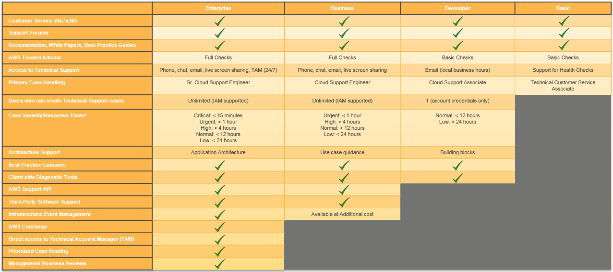
Support Comparison
Notes:
Now, compare the available support plans. All customers receive Basic Support included with an AWS account. All plans, including Basic Support, provide 24/7 access to customer service, AWS documentation, whitepapers, and support forums.
The comparison chart shown here is a helpful reference. If you would like to download or print the chart, select the link.
https://aws.amazon.com/premiumsupport/compare-plans/

Slide 23
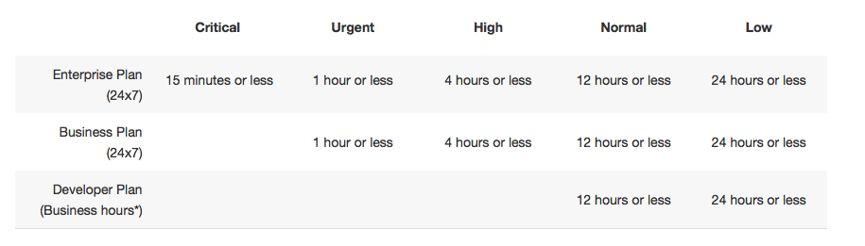
Case Severity and Response Times
Notes:
Here you can see a case severity chart with response times.
• When it’s critical, your business is at risk. Critical functions of your application are unavailable.
• When it’s urgent, your business is significantly impacted. Important functions of your application are unavailable.
• If it’s high, important functions of your application are impaired or degraded.
• When normal, non-critical functions of your application are behaving abnormally, or you have a time-sensitive development question.
• When it’s low, you have a general development question, or you want to request a feature.

Slide 24
Pricing
Basic | Developer | Business | Enterprise
Included | Greater of $29 - or - 3% of monthly AWS usage | Greater of $100 -or- 10% of monthly AWS usage for the first $0-$10K 7% of monthly AWS usage from $10K-$80K 5% of monthly AWS usage from $80K-$250K 3% of monthly AWS usage over $250K | Greater of $15,000 -or- 10% of monthly AWS usage for the first $0-$150K 7% of monthly AWS usage from $150K-$500K 5% of monthly AWS usage from $500k-$1M 3% of monthly AWS usage over $1M
Notes:
All AWS Support tiers include an unlimited number of support cases, with no long-term contracts. With the Business and Enterprise tiers, you earn volume discounts on your AWS Support costs, as your AWS charges grow.
For more information on estimating your deployment’s AWS Support costs, select the link.
http://calculator.s3.amazonaws.com/index.html

Slide 25
Pricing Examples
Business Pricing Example
For $85K in AWS monthly usage:
$10,000 x 10% = $1,000
(10% of the first $0 - $10K of usage)
+ $70,000 x 7% = $4,900
(7% of usage from $10K - $80K)
+ $5,000 x 5% = $250
(5% of usage from $80K - $250K)
+ $0 x 3% = $0
(3% of usage over $250K)
Total: $6,500
Enterprise Pricing Example For $1.2M in AWS monthly usage:
$150,000 x 10% = $15,000
(10% of the first $0 - $150K of usage)
+ $350,000 x 7% = $24,500
(7% of usage from $150K - $500K)
+ $500,000 x 5% = $25,000
(5% of usage from $500K - $1M)
+ $200,000 x 3% = $6,000
(3% of usage over $1M)
Total: $70,500
Notes:
Here is a comparison of business and enterprise pricing. Take a moment to compare the services.

Slide 26

Review
Revealed troubleshooting techniques to fix common errors.
Reviewed various AWS Support Options available.
Complete:
Knowledge Assessment
Notes:
In this module, you:
Explored troubleshooting techniques
And reviewed AWS Support Options
To finish this module, please complete the corresponding knowledge assessment.
26

Slide 27
Up Next: Module 15 Design Patterns and Sample Architectures
Notes:
In the next module, you will learn about design patterns and review sample architectures.

Slide 28
Thanks for participating!
© 2018 Amazon Web Services, Inc. or its affiliates. All rights reserved. This work may not be reproduced or redistributed, in whole or in part, without prior written permission from Amazon Web Services, Inc. Commercial copying, lending, or selling is prohibited. Corrections or feedback on the course, please email us at: aws-course-feedback@amazon.com. For all other questions, contact us at: https://aws.amazon.com/contact-us/aws-training/. All trademarks are the property of their owners.
Notes:
Thanks for participating!

